Slide 1
Angular
Directives & Displaying Data

Slide 2
Overview of the built-in directives

Slide 3
Agenda
Binding
Binding Events
Built-in directives

Slide 4
Angular
1
Binding Syntax

Slide 5
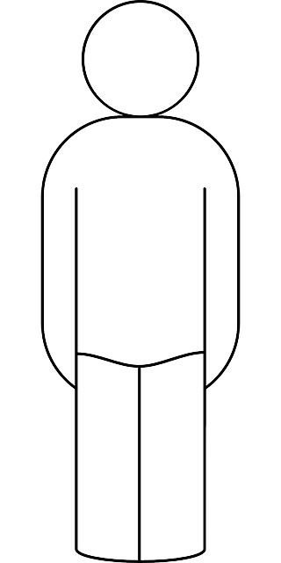
Binding
Name:
{
Name: DeRudder,
FirstName: Kevin
}
DeRudder
I’m
Kevin
First name:
Kevin
Save
Thank your for submitting, Kevin

Slide 6
Interpolation
Bind a property using {{ }}
Name:
{
Name: DeRudder,
FirstName: Kevin
}
DeRudder
I’m
Kevin
First name:
Kevin
Save
Thank your for submitting, Kevin
{{ FirstName }}

Slide 7
Interpolation
import { Component } from '@angular/core';
@Component({
selector: 'demo-app',
template: `
<p>Thank your for submitting, {{FirstName}}</p>
`
})
export class DemoComponent {
FirstName = 'Kevin';
Name = 'DeRudder';
}
Angular pulls the value from the components properties
Angular updates the display when these properties change

Slide 8
Binding displayed output values
Enclose extra text | data inside the brackets
This is called a PIPE and its purpose is to format the variable
<p>
Thank your for submitting, {{FirstName}} on {{today|date:'dd/MM/yyyy'}}
</p>

Slide 9

ONE WAY

Slide 10
Bind input fields – 2 way?
<input type="text" [(ngModel)]="Name" />
Name:
{
Name: DeRudder,
FirstName: Kevin
}
DeRudder
I’m
Kevin
First name:
Kevin
Save
Thank your for submitting, Kevin

Slide 11
2 way databinding
[(ngModel)]

Slide 12
Angular
2
Binding Events

Slide 13
Binding events
An application without events would be a word document?
click
mouseover
focus
blur
<input type="text" (focus)="toggleFocus()" [(ngModel)]="Name" />
<button (click)="save()">Save</button>

Slide 14
$event object
DOM events hold plenty of useful information
@Component({
selector: 'demo-app',
template: `<input type="text" (keyup)="onKey($event)"/>`
})
export class DemoComponent {
onKey(event: any) {
console.info(event.target.value);
}
}

Slide 15
$event object
The properties of the $event object depend on the DOM event
All standard DOM event object have a target property
Reference to the element that raised the event

Slide 16
$event casting
The easiest way to type the $event object is by using :any
No type information is available
Mistakes could occur if you use a property that is not available

Slide 17
Setting element properties
Angular 2 lets you set an element’s DOM property
Any DOM property is accessible

Slide 18
Angular
3
Built-in directives

Slide 19
Directive
Functionality added to our HTML elements to give dynamic behavior
Multiple directives available
Component Directives
Structural Directives
Attribute Directives

Slide 20
Built-in directives
Component directives
Form the main class having details of how the component should be processed, instantiated and used at runtime
Structural Directives
Deal with manipulating the DOM elements
Have a * before the directive (*ngIf, *ngFor)
Attribute directives
Deal with changing the look and behavior of the DOM element

Slide 21
NgIf
Display or hide an element based on a condition
Condition is based onf the result of the expression
When false the element will be removed from the DOM
<div *ngIf="role == 'Admin'">
<details>...</details>
</div>

Slide 22
NgSwitch
Render different elements depending on a condition
Avoid too many ngIfs
<div [ngSwitch]="city">
<div *ngSwitchCase="'Ghent'"></div>
<div *ngSwitchCase="'Antwerp'"></div>
<div *ngSwitchCase="'Brussels'"></div>
<div *ngSwitchDefault></div>
</div>

Slide 23
NgStyle
Set a given DOM element CSS properties form an expression
template: `
<div [style.background-color]="'orange'">
</div>
`

Slide 24
NgStyle
Set a given DOM element CSS properties form an expression
template: `
<div [style.background-color]="'orange'">
I hate you... </div>
`
Try to avoid, but in some cases it can be used (animations, ...)

Slide 25
NgClass
Now we are talking
Dynamically set and change the CSS class for a DOM element
template: `
<div [ngClass]="{bordered: isBordered}">
</div>
`

Slide 26
NgClass
template: `
<div class="base" [ngClass]="['bordered', 'shadowed']">
</div>
`
this.classList = ['bordered', 'shadowed'];

Slide 27
NgFor
Repeat a given DOM element and pass an element of the array on each iteration
<li *ngFor="let p of photos"></li>
Let specifies a variable that’s receiving each element of the items array

Slide 28
NgFor - index
Get an index for each iteration
<li *ngFor="let p of photos; let num = index"></li>

Slide 29
NgNonBindable
Tell Angular not to compile or bind a particular section of your page
<div class='ngNonBindableDemo’>
<span class="bordered">{{ content }}</span>
<span class="pre" ngNonBindable>
&larr; This is what {{ content }} rendered
</span>
</div>

